Slide 1
Text Analysis of the Politics Subreddit
Cole Sanders

Slide 2
Proposal
Pull data form the Politics Subreddit from both the Top and Controversial categories
Tokenize Text in Title and URL to look for common phrases
Build a model to show what combination of phrases, words, and websites are associated with higher scores and are more likely to appear in Top or Controversial
Build a Shiny Dashboard to help visualize the data and allow people to predict outcomes of using certain word and urls in a title

Slide 3
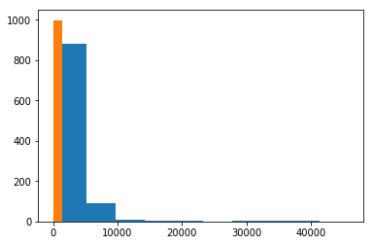
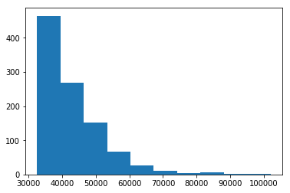
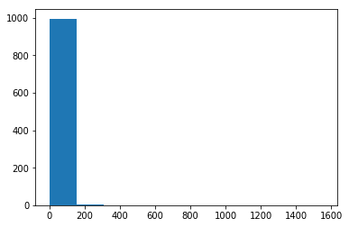
Controversial tends to have lower scores and comments than Top
Graph A: Number of Comments, Blue is Top, Orange is Controversial
Graph B: Score for Top
Graph C: Score for Controversial
By mixing Top and Controversial we get a good mix of high and low scoring post, however this causes score and category to be strongly related. This is why these features will be part of our outcome variables only, and will not be used in Prediction.
A
B
C

Slide 4
Most Frequent Domains
Top:
('thehill.com', 106),
('newsweek.com', 69),
('washingtonpost.com', 65),
('self.politics', 41),
('businessinsider.com', 37),
('cnbc.com', 35),
('cnn.com', 34),
('independent.co.uk', 30),
('thinkprogress.org', 28),
('commondreams.org', 27),
('nytimes.com', 26),
('huffingtonpost.com', 24),
('lawandcrime.com', 23),
('vox.com', 22),
('theweek.com', 18),
Controversial:
('thehill.com', 98),
('washingtonpost.com', 45),
('politico.com', 32),
('thedailybeast.com', 28),
('commondreams.org', 26),
('cnn.com', 26),
('theintercept.com', 26),
('washingtontimes.com', 25),
('newsweek.com', 23),
('nytimes.com', 22),
('rightwingwatch.org', 20),
('theguardian.com', 20),
('nypost.com', 18),
('washingtonexaminer.com', 16),
('jacobinmag.com', 16),

